Slide 1

Types of Trade Protectionism
4.2
Copyright Bananaomics

Slide 2

Definition
Free Trade
No barriers to trade between countries
Copyright Bananaomics

Slide 3
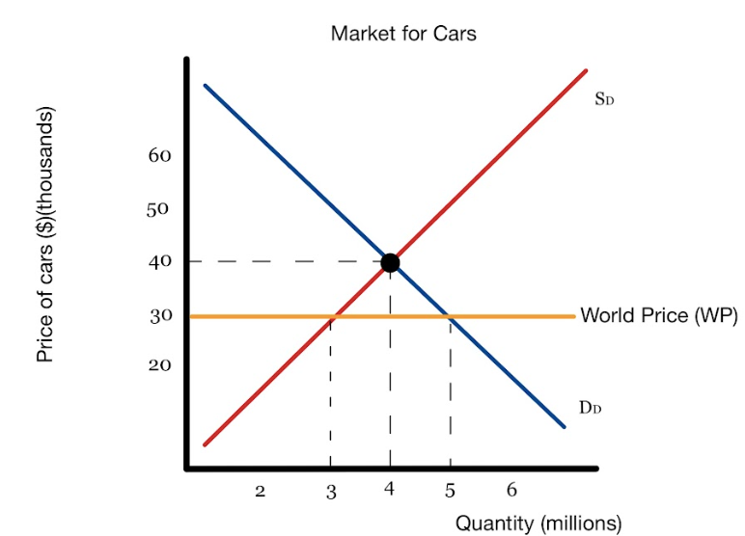
Free Trade
Using a free trade diagram, show the impacts on each main stakeholder:
  Consumer Surplus
  Producer Surplus
  Government
  Total Welfare/Surplus
Copyright Bananaomics

Slide 4
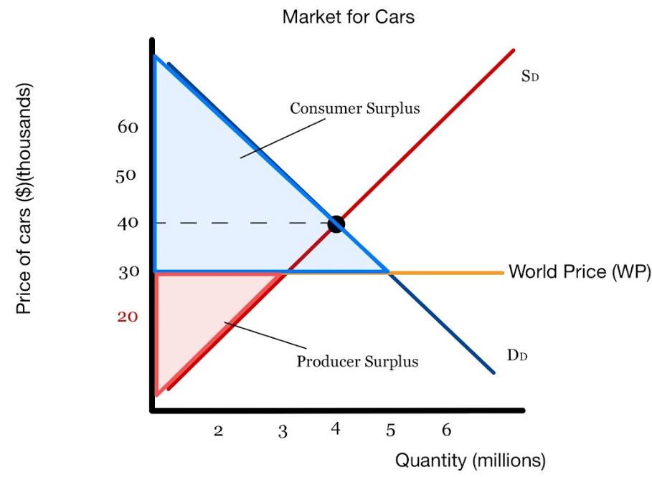
Free Trade Surplus Diagram
  Consumer surplus increases
  Domestic producer surplus decreases
  Total welfare/surplus increases
Winners: Consumers, Society
Losers: Domestic producers, Domestic unemployment rate and GDP
Copyright Bananaomics

Slide 5

Free Trade - EconplusDal
Copyright Bananaomics

Slide 6

Why would countries not want free trade? Discuss for 2 minutes with a partner.
Copyright Bananaomics

Slide 7

Definition
Trade Protection
Government intervention aiming to limit imports and/or encourage exports by setting
up trade barriers that protect from foreign competition
Copyright Bananaomics

Slide 8

Types of Trade Protectionism
Tariff
A tax placed on imported goods
Quota
A physical limit on the number or value of goods that are allowed to be imported
Subsidy
Money is given to domestic producers to increase competition and reduce domestic price.
Administrative Barriers
Health standards, paperwork "red tape", embargo
Copyright Bananaomics

Slide 9
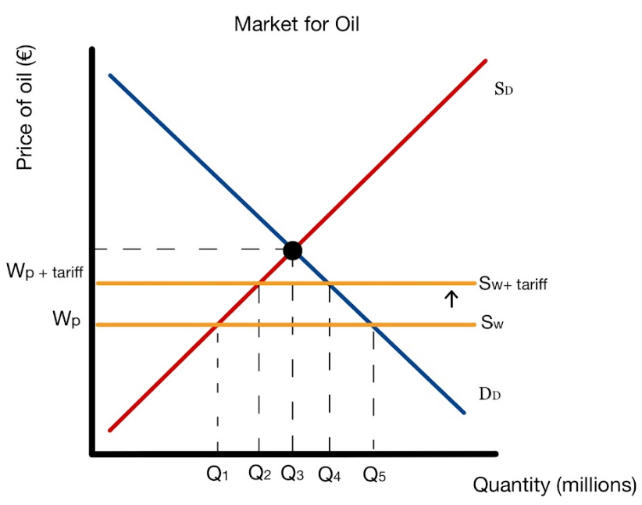
Tariff
Using the trade diagram, determine:
- the consumed quantity
- the quantity domestically sold
- the quantity imported
Copyright Bananaomics

Slide 10
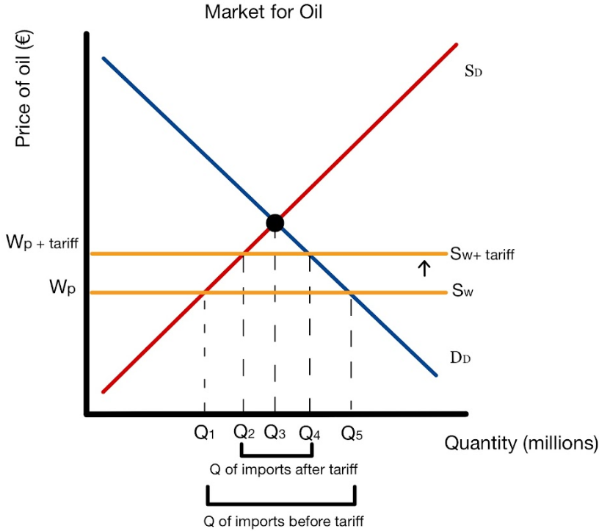
Tariff
Copyright Bananaomics

Slide 11
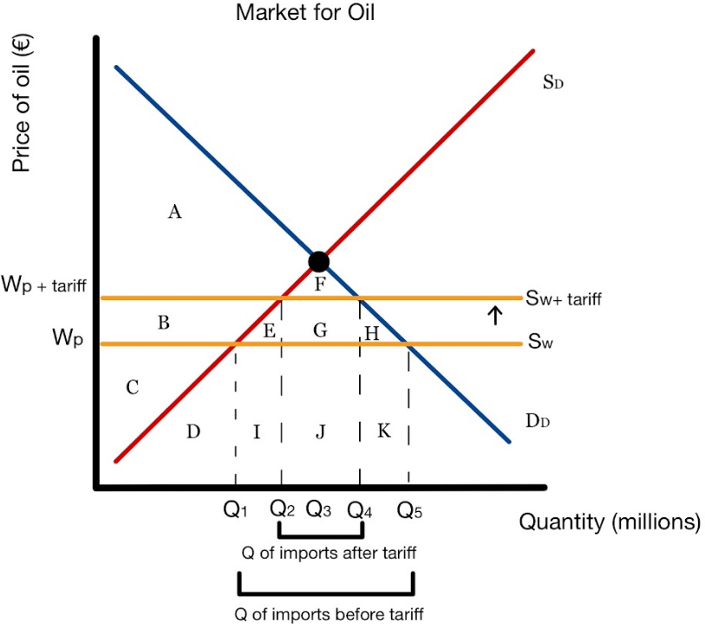
Tariff
Using the trade diagram, label the following after the tariff has been implemented:
  Consumer Surplus
  Producer Surplus
  Government
  Total Welfare/Surplus
Copyright Bananaomics

Slide 12
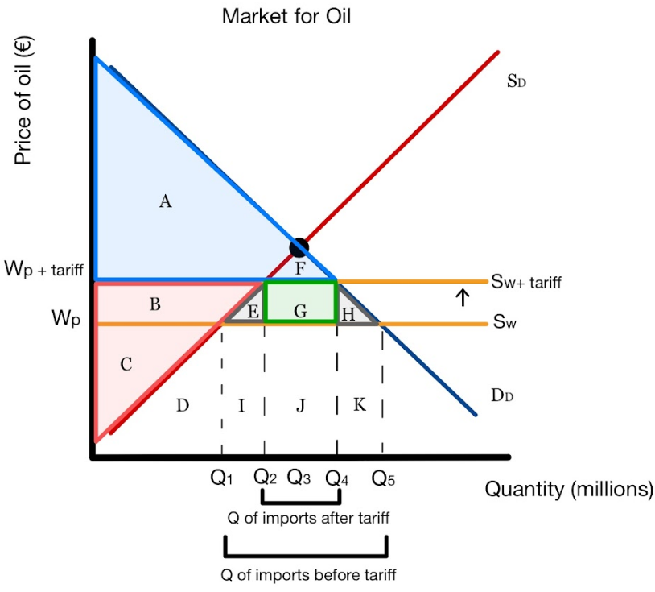
Tariff
Using the trade diagram, describe the impacts on each main stakeholder of enacting a tariff:
  Consumer Surplus A+F
  Producer Surplus B +C
  Government G
  Total Welfare/Surplus E+H
Copyright Bananaomics

Slide 13
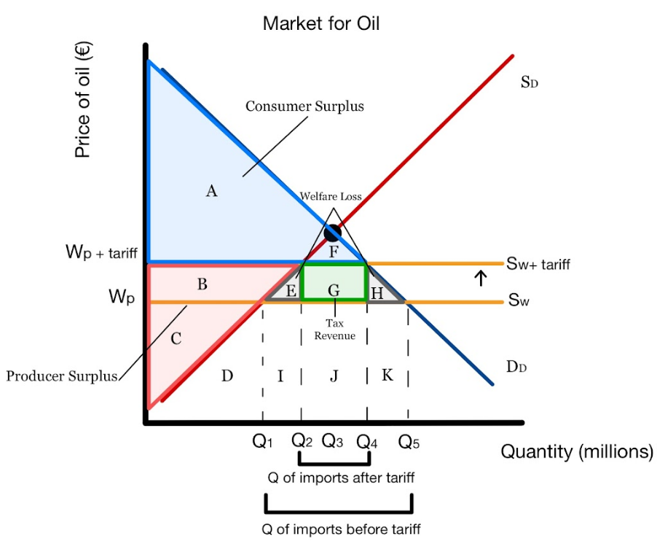
Tariff
  Consumer surplus decreases
  Domestic producer surplus increases
  Government receives revenue
  Total welfare/surplus decreases (2 areas of Deadweight Loss)
Winners: Domestic Producers, Government
Losers: Consumers, Foreign Producers, Society
Copyright Bananaomics

Slide 14

Tariff Effectiveness
Governments will also consider the elasticity and availability of goods that they put a tariff on.
Goods with elastic demand (Example: Steel)
Any tariff on a good with elastic demand generates a large change in quantity demanded and encourages consumers to switch to domestic producers as they offer a readily available substitute. Tariffs are more effective with elastic goods.
Goods with inelastic demand (Example: Insulin)
Due to the lack of available substitutes from domestic producers, tariffs on inelastic goods are not effective.
Copyright Bananaomics

Slide 15
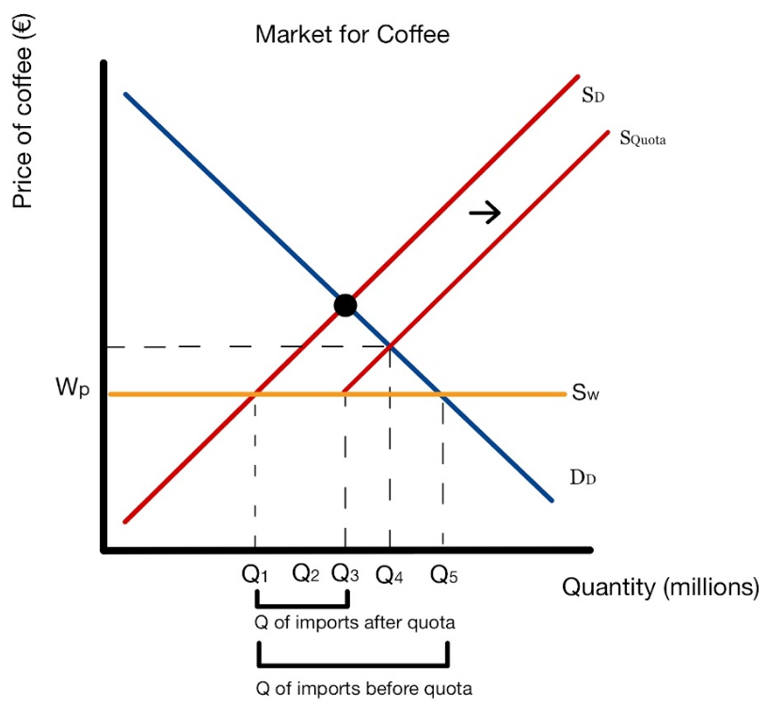
Quota
Copyright Bananaomics

Slide 16

Quota
Using the trade diagram, label the following after the quota has been implemented:
  Consumer Surplus A +G
  Producer Surplus C + B + H
  Government = NA
  Total Welfare/Surplus = I+ J
Copyright Bananaomics

Slide 17
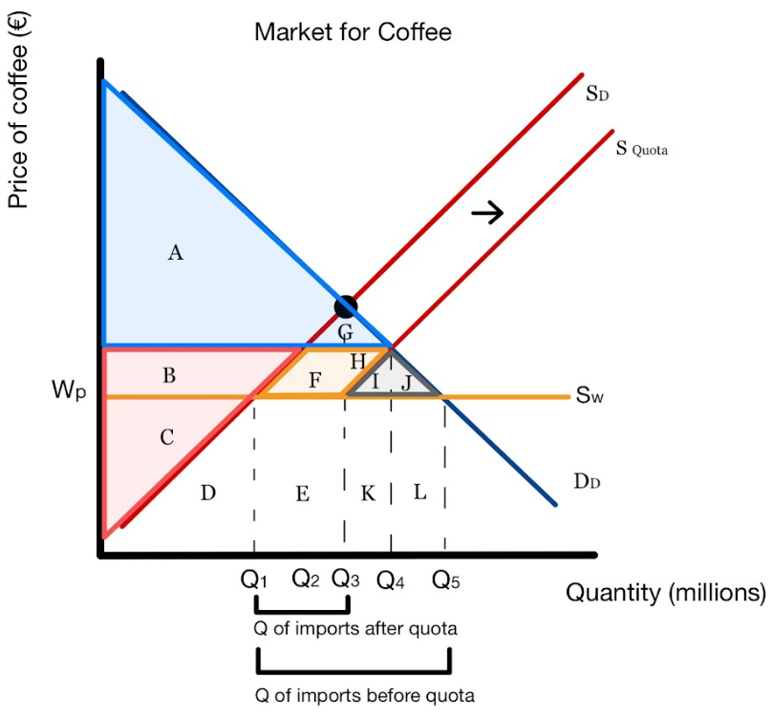
Quota
  Consumer surplus decreases
  Domestic producer surplus increases
  Government receives no revenue
  Total welfare/surplus decreases
Winners: Domestic Producers
Losers: Consumers, Foreign Producers, Society
Copyright Bananaomics

Slide 18
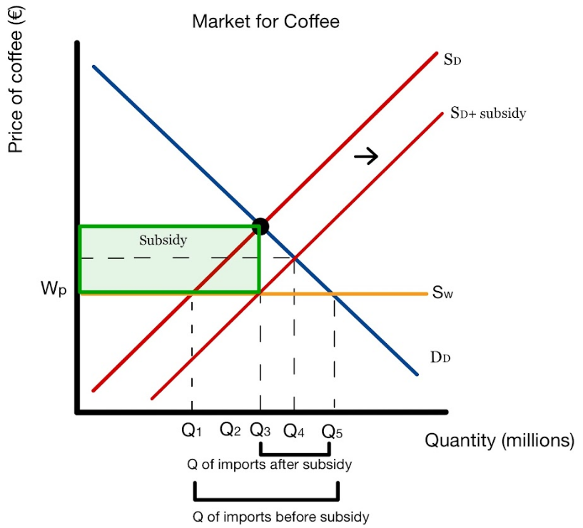
Subsidy
Using the diagram, show the impacts on each main stakeholder:
  Consumer Surplus
  Producer Surplus
  Government
  Total Welfare/Surplus
Copyright Bananaomics

Slide 19
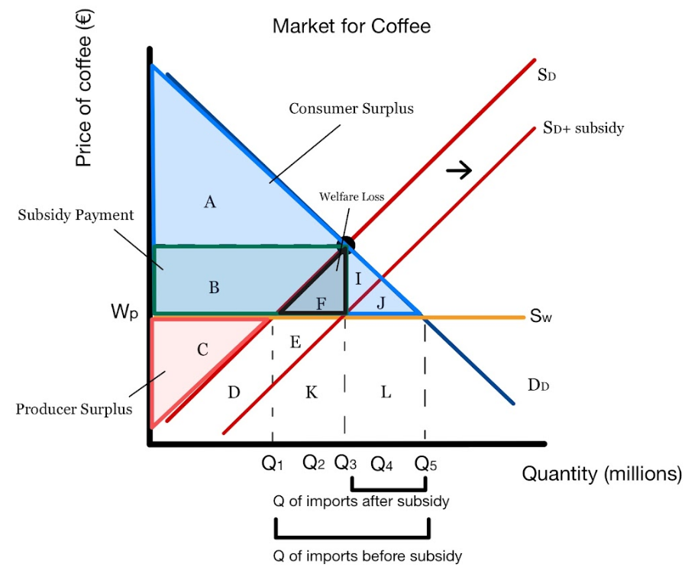
Subsidy
  Consumer surplus stays the same
  Domestic producer surplus increases
  Government must spend money
  Total welfare/surplus decreases
Winners: Domestic Producers, Consumers
Losers: Government, Foreign Producers, Society
Copyright Bananaomics

Slide 20


Administrative Barriers
Countries may choose to establish bureaucratic barriers preventing or disincentivizing foreign producers from importing goods or services.
  Product Standards
    Health and safety regulations
  Voluntary Export Restraint Agreement
    Agreement between two countries to limit the amount of exports/imports.
  'Buy National' Policies
    A marketing campaign to encourage domestic consumers to support local, domestic firms.
Copyright Bananaomics

Slide 21

Evaluation
All forms of protectionism result in some type of allocative inefficiency and reduction of total surplus/welfare.
Copyright Bananaomics

Slide 22

Practice Question
Copyright Bananaomics

Slide 23

Paper 1
Copyright Bananaomics

Slide 24
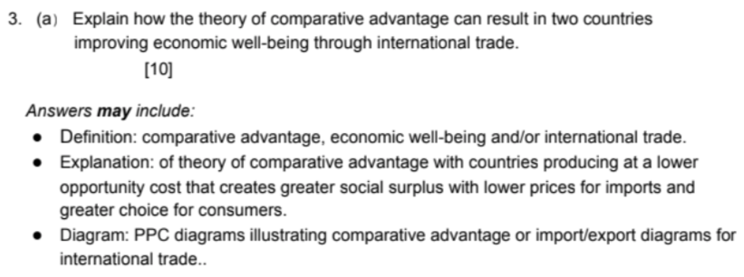
Mark Scheme
Copyright Bananaomics

Slide 25

Enjoying The Content?
Visit bananaomics.com to purchase package deals with discount prices!
BANANAOMICS

